Slide 1
Lecture 11. Index
Instructor: 黄群
huangqun@pku.edu.cn
School of EECS
Peking University

Slide 2
Outline
Basic concepts
Linear index, secondary index
Inverted index
Static index (Multiway Tree)
Dynamic index (B/B+ trees)

Slide 3
Scenario: Entry-Sequenced File
Entry-Sequenced Files are common form in disks
Order records by insertion time
as an unordered sequential list
search with sequential search
inefficient search
Indexing needed to support efficient search

Slide 4
Primary and Secondary Key
A record contains multiple keys
Primary key (主码)
The unique id of record
For example: student id
Non-duplicate
Secondary key (辅码)
For example: student name, age, major …
Can be duplicate

Slide 5
Indexing
(20,a9) (21,a10)
(45,a13)(47,a14)
(50,a5) (52,a16)
Indexing – (key, pointer)
pointers to the complete record in the data file
Indexing is important for large-scale databases
Efficient search
Insert, modify, delete
Not only primary key needs index, secondary keys also matter

Slide 6
Index File: Store Index Information
A primary data file may have multiple index files
Each index file support a specific key
No need to rearrange the primary data file
The index files help the efficient search of records given a key
Primary index file
Index file for primary key

Slide 7
Dense vs. Sparse Index
Dense index（稠密索引）
an index is created for each record
the records in the data file are not in order
Sparse index（稀疏索引）
an index is created for a group of records
the records are partitioned into groups (blocks)
an index is created for the starting position of each group
the records in a group are usually in order

Slide 8
Outline
Basic concepts
Linear index, secondary index
Inverted index
Static index (Multiway Tree)
Dynamic index (B/B+ trees)

Slide 9





Linear Index
Index: sort according to a specific key
Each pointer points to the position of a record
Linear Index File
Records
92
73
37
55

Slide 10
Disadvantages of Linear Index
The index may store in external storages
Needs multiple external accesses, and affects the search efficiency
Solution: use secondary linear index
Inefficient to update the linear index
when records are inserted or deleted

Slide 11
Secondary Index
Motivation: indexing information can also be huge
For example, a block in the hard disk is 1024 bytes, and a (key, pointer) pair takes 8 bytes
A block can store 128 index pairs
Assume the data file has 10000 records (10000 pairs for linear index)
10000 / 128 = 78.1
Linear index takes 79 blocks
Secondary Index: index for linear index tuples
A secondary index has 79 pairs
This secondary index file can fit in a block

Slide 12
Secondary Index: Example
A key in the secondary index
is a key of the first record in the referred primary index
The pointer in the secondary index
points to the starting location of the corresponding block in the primary index
Secondary index
Primary index

Slide 13
Outline
Basic concepts
Linear index, secondary index
Inverted index
Attributed based
Text based
Word Index
Full-text Index
Static index (Multiway Tree)
Dynamic index (B/B+ trees)

Slide 14
Two Types of Inverted Index
Attributed based (for databases)
Index according to one or more attributes
Specific requirements on the indexed attributes
Text based (for text files)
Index according to words in a text

Slide 15
Attributed based Inverted Index
Inverted Index table:
elements have form (attribute value, pointer list)
Pointer list contains all records that have this attribute value
Pointer can be either primary key or record address
Requirement: attribute values are discrete
Continuous values typically used B/B+ trees
Inverted Index File: a file that stores inverted index table

Slide 16
Attributed based: Example
EMP# | NAME | Department | Profession | Specialty | Address
0155 | 李宇 | 数学 | 教授 | 代数 | C105
0421 | 刘阳 | 外语 | 助教 | 英语 | E310
0208 | 赵亮 | 物理 | 助教 | 力学 | C211
0211 | 张伟 | 物理 | 讲师 | 原子物理 | D508
0132 | 王亮 | 数学 | 助教 | 几何 | E220
0119 | 王卓 | 数学 | 讲师 | 代数 | B102
0330 | 孙丽 | 计算机 | 教授 | 软件 | A108
0455 | 刘珍 | 外语 | 讲师 | 法语 | A225
0310 | 周兵 | 计算机 | 讲师 | 英语 | B423
0341 | 何江 | 计算机 | 助教 | 计算机 | F406
……

Slide 17
Attributed based: Example
Department list
EMP#
数学
物理
计算机
外语
0155, 0132, 0119
0208, 0211
0330, 0310, 0341
0421, 0455
Profession list
EMP#
教授
讲师
助教
0155, 0330
0211, 0119, 0455, 0310
0421, 0208, 0132, 0341
Specialty list
EMP#
代数
几何
力学
原子物理
软件
英语
法语
0155, 0119
0132
0208
0211
0330, 0341
0421, 0310
0455

Slide 18
Attributed based: Pros and Cons
Pros
Efficient lookup for various attributes
Cons
Storage cost for inverted index table
Computational overheads when updating original data

Slide 19
Text based Inverted Index
Build an inverted index table to locate file contents
Possible methods
Word index
Full-text index

Slide 20
Text-based: Word Index
Key idea
Retrieve keywords for each text
Data structure: keywords -> text locations
Need to parse text into words (segmentation)

Slide 21
Text-based: Full-text Index
Key idea
A text is a long string
Data structure: substring -> start locations
Pros
Lookup arbitrary content
Not limited to key words
Cons: storage overheads

Slide 22
Word Index is More Common
We focus on Word Index in the remaining
Every keyword points to a posting list
Posting list
The files containing this keyword +
Locations of the keyword in these files

Slide 23
Word Index: Example
Doc Id
Text Content
1
Please porridge hot, please porridge cold,
2
Please porridge in the pot,
3
Nine days old.
4
Some like it hot, some like it cold,
5
Some like it in the pot,
6
Nine days old.

Slide 24
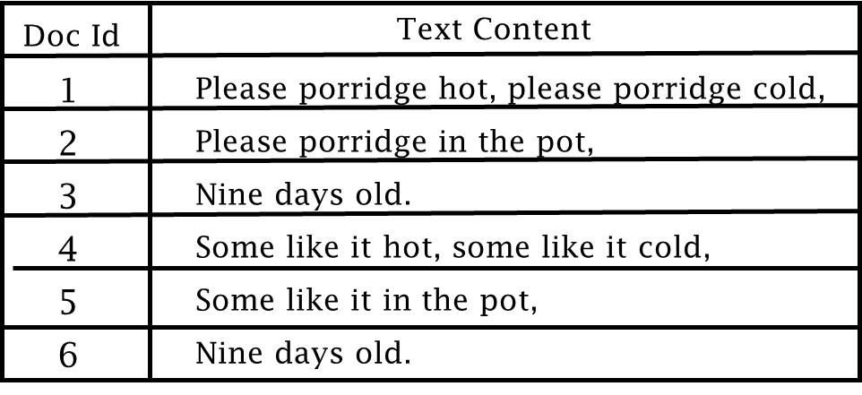
倒排索引
编号
词语
（文档编号，位置）
1
cold
(1,6)
2
days
3
hot
(1,3)
4
in
5
it
6
like
Process Remaining Words
7
nine
Process Doc 2
8
old
9
please
(1,1)
(1,4)
（2,1）
10
porridge
(1,2)
(1,5)
11
pot
12
some
13
the

Slide 25
Build Text-based Inverted Index File
Step 1: process each document
Partition a document into several text records
The granularity of a record depends on practical applications
A fixed-length block
A paragraph
A section / a chapter
Even an entire document

Slide 26
Build Text-based Inverted Index File
Step 2: retrieve keywords for each text record
Techniques
Segmentation: partition into words / phases
E.g.: “Data Structure” should be a keyword
Stop word: discard common but useless words
E.g.: “the”, “is”, “are”, “that” …
Stemming: deal with different forms of the same word

Slide 27

Build Text-based Inverted Index File
Chinese Segmentation: hard problem
我知道，你不知道。我知道，你不知道我知道，你不知道
我知道你，不知道我。知道你不知道我，知道你不知道
我，知道你不知道我知道。你，不知道我知道你不知道
我知道你不知道我知道你不知道我知道你不知道

Slide 28
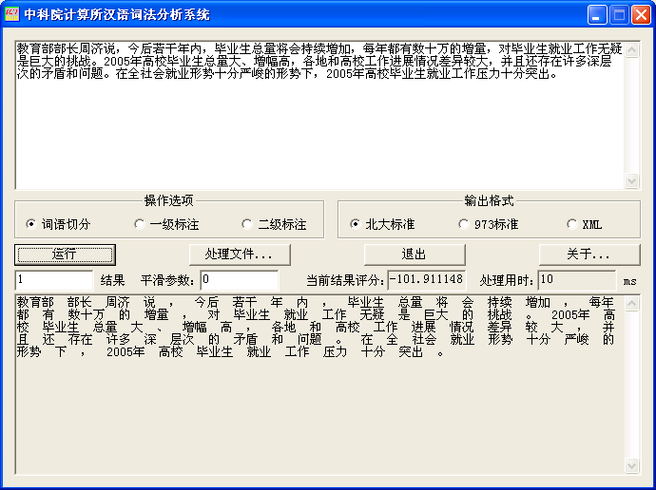
Build Text-based Inverted Index File

Slide 29
Build Text-based Inverted Index File
Step 3: Build inverted index table, and then inverted index file
After getting keywords
Build posting list of each keyword
Store posting lists into files

Slide 30
Lookup Keyword with Inverted Index Files
Step 1: Locate keyword in inverted index files
Step 2: Get the posting list, get records from the posting list
To locate keyword more efficiently, need specific data structures
Hash table
Trie

Slide 31
Text-based: Pros and Cons
Pros: efficient lookup for text files
Cons:
Limited query: only keywords
Storage cost for inverted index tables
Hard to update

Slide 32
Outline
Basic concepts
Linear index, secondary index
Inverted index
Static index (Multiway Tree)
Dynamic index (B/B+ trees)

Slide 33
Static Index: Multiway Tree
Static index
The index structure is created when the data file is initialized
Fixed once created
Only changes with an explicit reorganization
Binary trees?
A more efficient method: multi-way tree
Reduce the number of external access

Slide 34
Multi-Way Trees
Definition: a tree that can have more than two children
A multi-way tree of order m (or an m-way tree):
A tree can have m children
Compared to binary tree:
Multi-way tree is flatter
Less disk accesses

Slide 35
Binary tree to multi-way tree
2 reads of index blocks
Each index block can contain 7 nodes
1 read of data block
63
Notes:
35
结点更大
以更少的外存访问次数来完成查找
需要较大的缓冲区
读入一个结点也需较多时间
一个结点最好能放在一个磁盘块中

Slide 36
Application: ISAM
ISAM (Indexed Sequential Access Method)
Based on multiway-tree to optimize external access
Multi-level indexing
Master index (optional)
Cylinder index 柱面索引
Track index 磁道索引
IBM widely adopted ISAM before the B+ tree-based VSAM (Virtual Storage Access Method)

Slide 37
Outline
Basic concepts
Linear index, secondary index
Inverted index
Static index (Multiway Tree)
Dynamic index
B Tree
B+ Tree

Slide 38
Goal
Index data structure changes as record insertion and deletion
Keep lookup efficiency

Slide 39
B Tree and B+ Tree
A balanced multi-way tree
B tree
Internal nodes: records & indices
Leaves: records & indices
B+ tree
Internal nodes: indices
Leaves: records

Slide 40
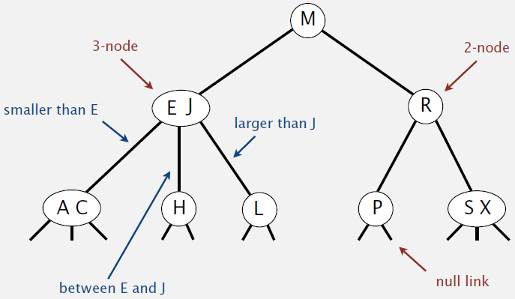
3-order B Tree (2-3 tree)

Slide 41
Formal Definition for m-order B tree
Each node has at most m children
Each node has at least ceil(m/2) children, except root and leaves
Root has at least two children
Except when root is a leaf (single-node B tree)
All leaves are at the same level
A node that has k children contains k-1 keys

Slide 42
Properties
Height balance: all leaves in the same level
No duplicate keys: keys in parent node are boundaries for children
Close keys are in the same disk block
Better locality
At least a portion of nodes are full
Better storage usage
Less disk accesses

Slide 43
B Tree Node Structure
j keys, j+1 pointers
where Ki denotes key, and K1 < K2 < … < Kj,
Pi is the pointer to the subtree whose nodes are larger than Ki and smaller than Ki+1
What does pointers mean here? A disk block!

Slide 44
B Tree Node Structure
Each node has three fields
Key
Pointers to child nodes
Address in disk files
<Key, record addr>

Slide 45
3-order B Tree (2-3 Tree)
18 33
12
23 30
48
10
15
20 21
24
31
45 47
50 52

Slide 46
B Tree Operations
Search
Insert
Delete
Need to maintain B-Tree properties

Slide 47
B Tree: Search A Key T
Read root node, assume root node contains key K₁，…，K_{j}
If the look up key T in {K₁，…，K_{j} }
Search hit
Otherwise
Find interval p_{i} containing T
Follow associated link of p_{i} (recursively)
If p_{i} is null pointer, search miss

Slide 48
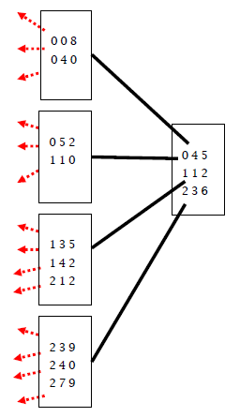
B Tree: Depth Analysis
N keys -> N+1 null pointers
Assume null pointers at level k
Level-0: root
Level-1: at least 2 node
Level-2: at least node
Level-k: at least node

Slide 49
B Tree: Depth Analysis
For example：
N = 1,999,998, m = 199
k = 4

Slide 50
B Tree: Insertion
Properties to maintain
All leaves at the same level
Each node has at most m-1 keys and m children
Procedure
Find the proper node in the bottom level, insert
If overflow, split the node, promote the middle key to parent node
If parent node overflow, continue split until reach the root
Split the root if necessary (the tree grows by one level in this case)

Slide 51
Insertion Example
m=3, Insert14
18 33
12
23 30
48
10
15
20 21
24
31
45 47
50 52
14

Slide 52
Insertion Example
m=3, Insert 55
18 33
12
23 30
48
50 52
10
14 15
20 21
24
31
45 47
50 52
55

Slide 53
Insertion Example
m=3, split leave, promote 52 (middle key)
18 33
12
23 30
48
10
20 21
24
31
45 47
52
50
14 15
50
55

Slide 54
Insertion Example
Insert 19, Cause Root Node to Split
18 33
12
23 30
48 52
19 20 21
10
14 15
20 21
24
31
45 47
50
55
19

Slide 55
Insertion Example
m=3, split leave node
18 33
12
23 30
48 52
23 30
19 20 21
50
55
10
14 15
19
20
21
24
31
45 47

Slide 56
Insertion Example
m=3, split the 2nd level
18 33
18 33
20
23
30
48 52
12
20 23 30
10
14 15
19
21
24
31
45 47
50
55

Slide 57
Insertion Example
m=3, split root
18
23
33
12
20
30
48 52
10
14 15
19
21
24
31
45 47
50
55

Slide 58
Disk Access of Insertion
Insert 14, 55, 19
Assume that all blocks are cached in memory after read
Read blocks: 7 (a,b,f; d,k; c,g)
Write blocks: 11 (f; k,k’,d; g,g’,c,c’,a,a’,t)
After insertions
t
23
a
18
33
a’
Before insertions
c
a
18 33
b
12
20
c’
30
48 52
d
b
12
c
23 30
d
48
10
14 15
19
21
24
31
45 47
50
55
e
f
g
g’
h
i
j
k
k’
10
15
20 21
24
31
45 47
50 52
e
f
g
h
i
j
k

Slide 59
Number of Splitting
After inserting N keys, there are p nodes
At the beginning: single node without key
After the N insertions, average splitting number
Root node
Other nodes

Slide 60
B Tree: Deletion
Find the key for deletion
If not a leaf, swap the key with its inorder successor, until reach a leave
Delete the key in leaf node
Underflow: a node has less than ceil(m/2)-1 keys after deletion?
If sibling has sufficient keys (> ceil(m/2)-1)
Redistribute: borrow key from sibling
Step 1: Promote the largest value of left sibling node to parent
Step 2: Pull the proper key from the parent (next key of the promoted one)
If sibling has no sufficient keys (= ceil(m/2)-1)
Merge: all keys in left sibling, middle key in the parent, and current key
Need to further deal with parent node if parent node underflows

Slide 61
Example: Delete in a 5-Order B Tree
a
80
c
b
25 50
92 96
d
e
f
g
h
i
11 15
35 43
61 65 70
81 85 86 90
94 95
97 98

Slide 62
Example: Delete in a 5-Order B Tree
a
Swap with successor
80
Delete 92 , h underflows
Borrow from left sibling
b
c
96
92
25 50
94
d
e
f
g
h
i
11 15
35 43
61 65 70
81 85 86
95
97 98
90
95
95
94
Delete value 92，Swap with successor，Underflow after deletion，Borrow from left sibling

Slide 63
Example: Delete in a 5-Order B Tree
To Delete 96
Swap with successor
a
Delete 96 , i underflow
Try to borrow from left sibling h
80
Left sibling has no sufficient keys, merge h and i
b
c
96
25 50
90
d
e
f
g
h
i
11 15
35 43
61 65 70
81 85 86
94 95
98
94 95
98
97

Slide 64
Example: Delete in a 5-Order B Tree
Merge h, i into h’
c underflow，try to borrow from left sibling b
Left sibling has no sufficient keys, merge b and c
a
80
b
a’
c
90
25 50
25 50 80 90
90
25 50
d
e
f
g
h’
11 15
35 43
61 65 70
81 85 86
94 95 97 98

Slide 65
Outline
Basic concepts
Linear index, secondary index
Static index (Multiway Tree)
Inverted index
Dynamic index
B Tree
B+ Tree

Slide 66
B+ Tree
A variant of B tree
All keys appear in leaf nodes
Each non-leaf node
Record max(min) values in its children nodes
70
40 90
20 30 40
50 60
70
80
90
5 10 20
25 30
35 40
45 47 50
55 60
65 70
75
80
85 90

Slide 67
B+ Tree: Property
Each node has at most m children
Each node has at least ceil(m/2) children, except root and leaves
Root has at least two children
Except when root is a leaf
All leaves are at the same level
A node that has k children contains k keys

Slide 68
Benefits of B+ Tree
All keys are sorted in the leave nodes
We can chain leave nodes
Other levels can also be chained
Allow range lookup
70
40 90
20 30 40
50 60
70
80
90
5 10 20
25 30
35 40
45 47 50
55 60
65 70
75
80
85 90

Slide 69
B+ Tree: Search
70
40 90
20 30 40
50 60
70
80
90
5 10 20
25 30
35 40
45 47 50
55 60
65 70
75
80
85 90
Keep searching until reach the bottom level
Example: Lookup 80

Slide 70
B+ Tree: Insertion
Similar to B Tree
Need to split when number of keys exceeds m
Update the maximum key in upper levels
70
40 90
20 30 40
50 60
70
80
90
5 10 20
25 30
35 40
45 47 50
55 60
65 70
75
80
85 90

Slide 71
Example
m=3, insert 15
a
40 70 90
b
c
d
20
30 40
50 60 70
80 90
e
f
g
h
i
j
k
l
5 10
25 30
35 40
10
20
48 50
55 60
65 70
75 80
85 90
15

Slide 72
Example
Tree height increases by 1 after insertion
t
40 90
a
a’
40
70 90
b
m
c
d
10 20
30 40
50 60 70
80 90
20
e
f
g
h
i
j
k
l
5 10
15 20
25 30
35 40
48 50
55 60
65 70
75 80
85 90

Slide 73
B+ Tree: Deletion
Similar to B Tree, when underflow occurs
Redistribution or merge with sibling nodes
New in B+ Tree: when delete a key
Need to update max(min) in the upper levels

Slide 74
Example
M=3, Delete 75
Delete 75，Underflow，Merge with right sibling, delete 80 in parent
Parent node under flow, borrow a key from left sibling
Update root
70
60
40 90
20 30 40
50 60
70
80
90
5 10 20
25 30
35 40
45 47 50
55 60
65 70
75
80
85 90

Slide 75
Another Variant of B+ Tree
Use different orders for leave and non-leave nodes
Non-leave nodes form B Tree
Leave nodes contain all keys

Slide 76
Example
Delete key 33
33
Underflow
18
23
48
10 12 15
18 19 20 21 22
23 30 31
33
45 47
48 50 52
Leave order 5，Non-leave order 4
Merge

Slide 77
Example
Delete key 33
Redistribution
Underflow
33
18
23
10 12 15
18 19 20 21 22
23 30 31
45 47 48 50 52
Leave order 5，Non-leave order 4

Slide 78
Example
Delete key 33
23
18
33
10 12 15
18 19 20 21 22
23 30 31
45 47 48 50 52
Leave order 5，Non-leave order 4

Slide 79
B Tree VS B+ Tree
Node of B Tree: 3 fields
Key
Pointer to child nodes
Address in disk file
Node of B+ Tree: 2 fields
Key
Pointer to child nodes

Slide 80
B Tree VS B+ Tree
Denote the size of page block as k
Assume key, pointer and address have equal size, s
Max order for B tree: k/(3s)
Max order for B+ tree: k/(2s)
B tree is taller, B+ tree is more efficient

Slide 81

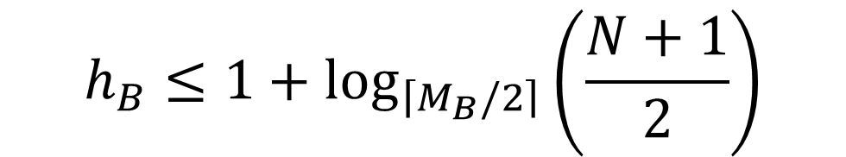
B Tree VS B+ Tree
Max order for B tree: m_{B} = k/(3s)
Max order for B+ tree: m_{B+} = k/(2s)
Assume each node is half loaded (i.e., with ceil(m/2) keys)
With N keys
Height of B tree
Height of B+ tree
$$h_{B}≤1+\log_{\left\lceil M_{B}/2\right\rceil }\left(\frac{N+1}{2}\right)$$
$$h_{B+}≤\log_{\left\lceil \frac{M_{B+}}{2}\right\rceil }{N}$$

Slide 82

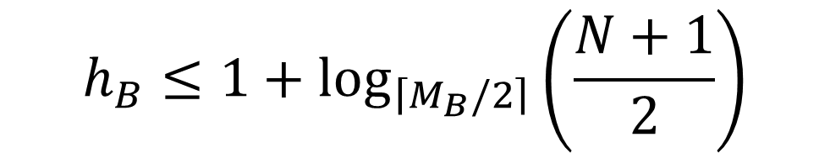
B Tree VS B+ Tree
m_{B} = k/(3s)
m_{B+} = k/(2s)
Height of B tree
Height of B+ tree
$$h_{B}≤1+\log_{\left\lceil M_{B}/2\right\rceil }\left(\frac{N+1}{2}\right)$$
$$h_{B+}≤\log_{\left\lceil M_{B+}/2\right\rceil }{N}$$
Let k = 1KB = 1024 bytes, s=4 bytes
m_{B} = 85, m_{B+} = 128

Slide 83
Summary
Basic concepts
Linear index, secondary index
Inverted index
Static index (Multiway Tree)
Dynamic index (B/B+ trees)

